Slide 1

Line Follower Robot design and implementation
Grand PrIEEE Competition 2017
10/22/2016
Ihab Salameh

Slide 2
Outline
What is a line follower
Why is it useful
System design and challenges
Expectations and timeline
Resources and logistics
Team selection

Slide 3
Project description
To design, test and implement a robot that can detect an arbitrary track and race autonomously with a $500 budget

Slide 4
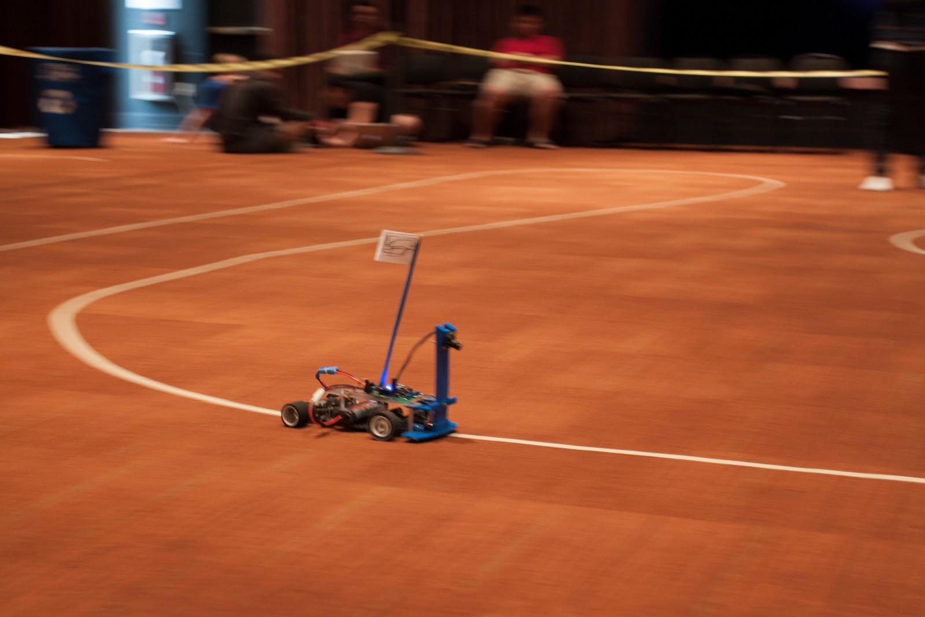
Introduction
Detects line based on color contrast or freq
Target speed is 10 ft/s
Source: jacobsschoolofengineering.blogspot.com

Slide 5
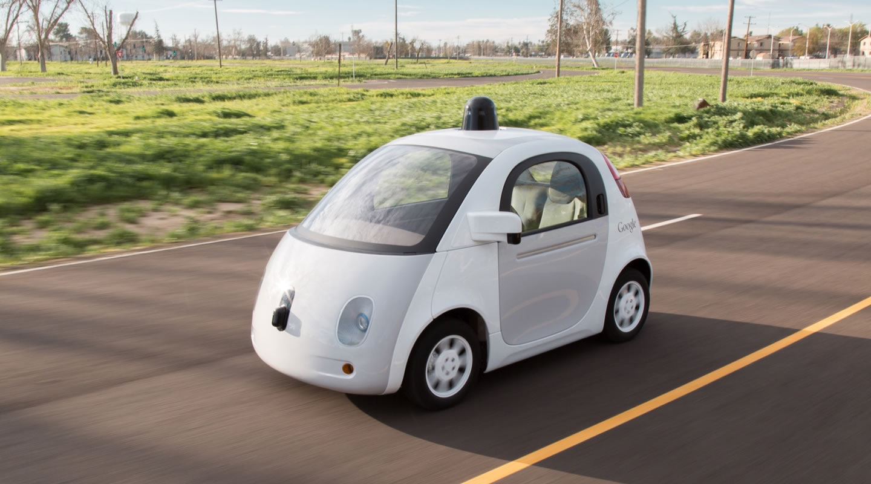
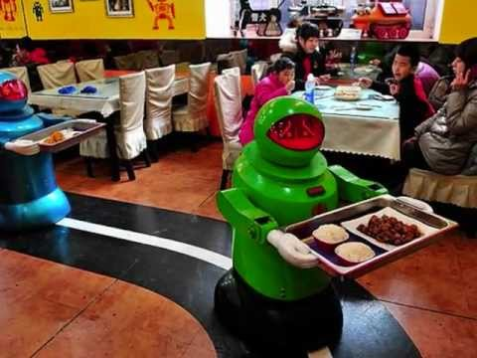
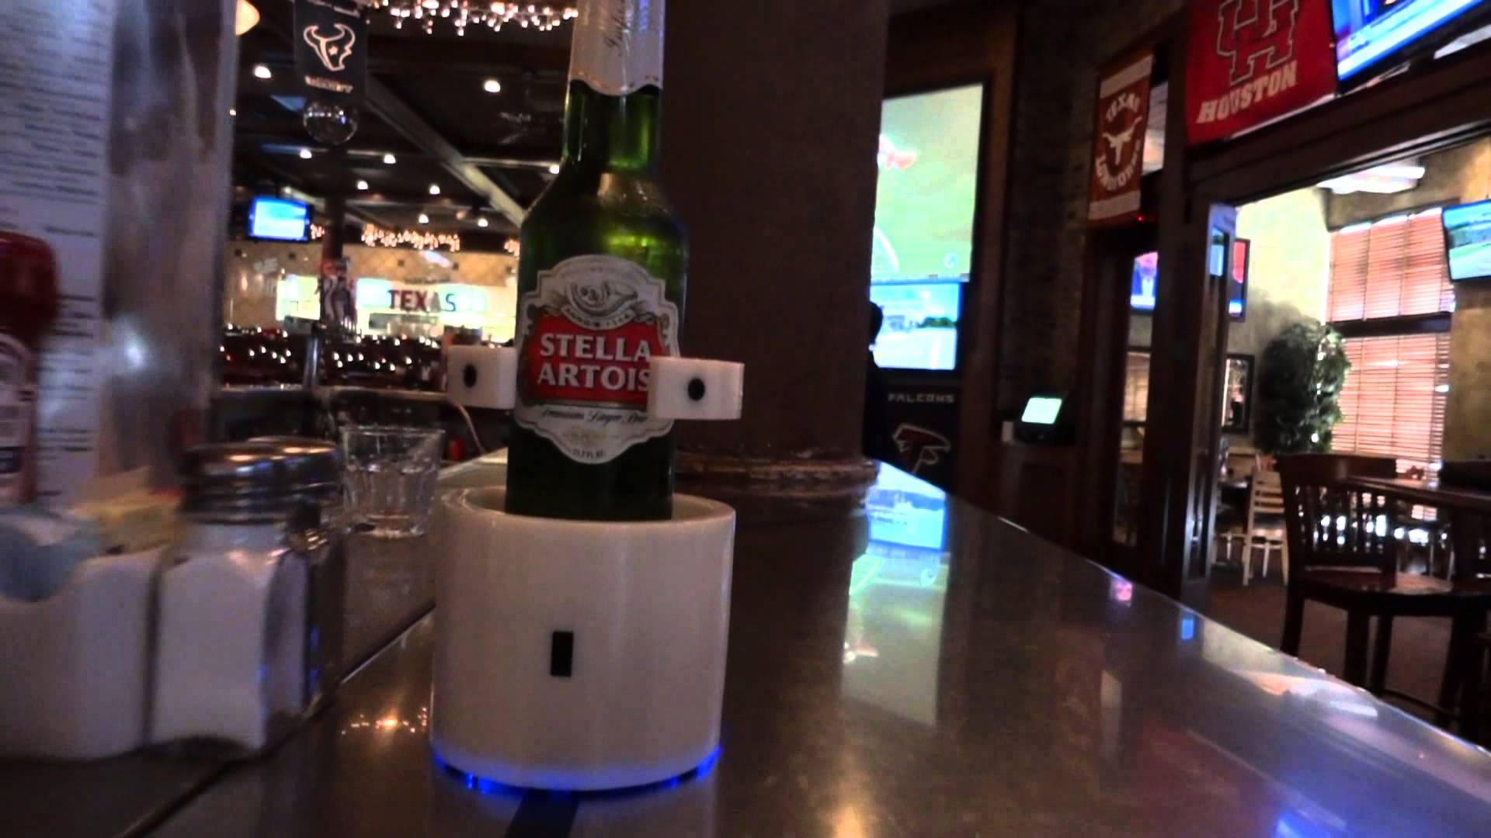

Applications
Self Driving Cars
Meal Serving
Drink Runner
Source: www.google.com/selfdrivingcar/
Source:
http://article.wn.com/view/2015/05/20/Robots_serve_meals_in_China/
Source:
www.youtube.com

Slide 6
System architecture
Encoder
Motor Driver
(H-Bridge)
Motor
5V
12V
Processing Board
(Arduino/Beagle-Bone)
5V
Line Scan Camera
Servo
5V
6V
Voltage Regulator
Battery
(Li-Po)
5V
12V
6V

Slide 7
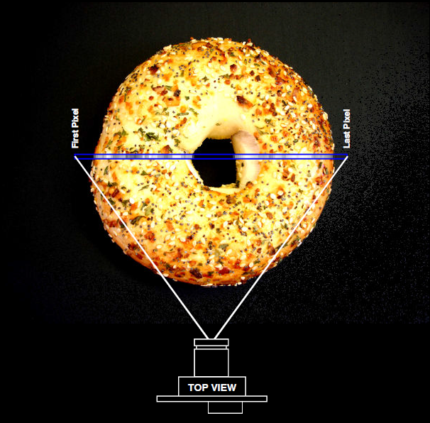
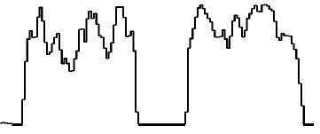
Line-Scan Sensor
Parallax TSL1401-DB
Linear array of 128 photodetectors
Outputs analog intensity for each pixel (0V – 5V)
Field of view equal to subject distance
Must meet clock timing requirements (min 5 kHz)
Source: TSL1401-DB Manual

Slide 8
Line Detection I
Analog data is sampled using BBB’s ADC subsystem
12-bit ADC converts (0-5V) (0-4095) integers
Utilized the Programmable Real-Time Unit (PRU) to meet timing requirements (10 KHz ~ 78 frame/sec)

Slide 9
Median filter

Slide 10
Gradient Filter
Look for maximum slopes
Line center determined by
taking the average of those
indices

Slide 11
Adaptive thresholding
Problem:
Need to accommodate for different lighting conditions
Brighter setting requires larger threshold
Solution:
Width requirement (~ 4-8 pixels) when FOV = 25”
Set threshold relative to average of all pixel values

Slide 12
Steering control I
Started with Proportional controller
Moved to Proportional, Integral,
Derivative controller (PID)
Needed to model the system
Chose a geometric model

Slide 13
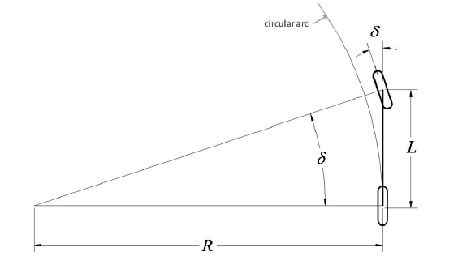
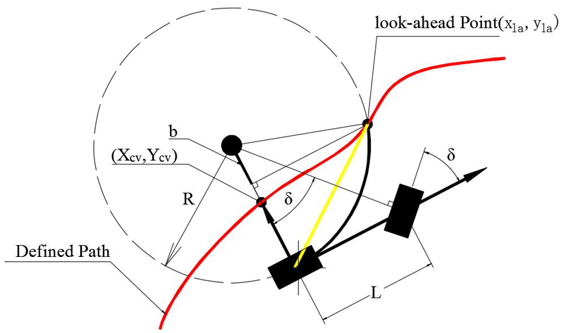
Steering control ii
Bicycle model
Pure Pursuit method
Source: Snider CMU-RI-TR-09-08
Source: intechopen.com

Slide 14
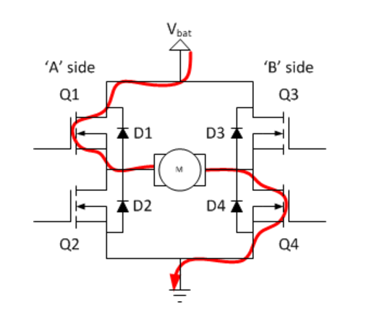
Speed control (h-bridge basics)
Source: ModularCircuits.com

Slide 15
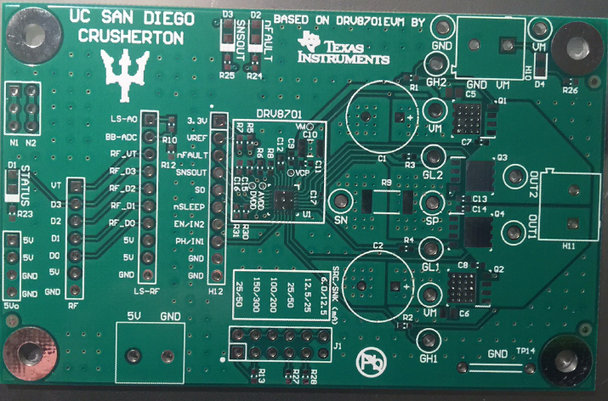
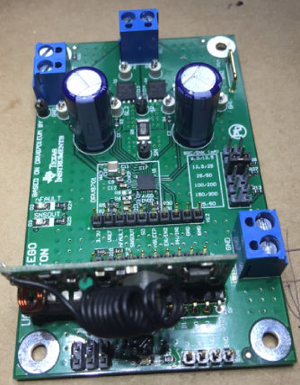
Speed control I
Designed and tested H-Bridge
Fabricated and soldered PCB
Set Pulse Width Modulation
(PWM) frequency to 20KHz
Smoother response
Lower torque ripple

Slide 16
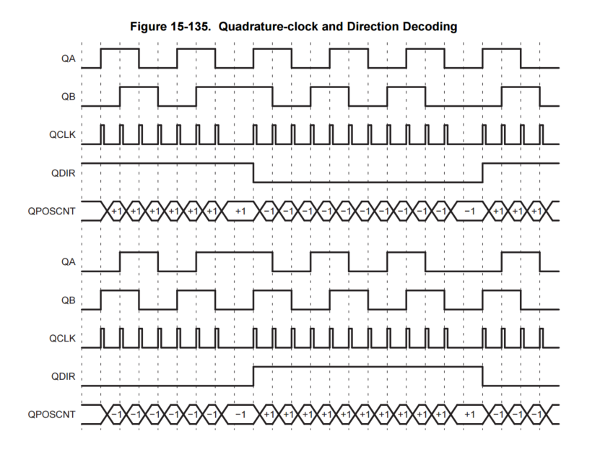
Speed control II
Used quadrature encoder
Speed based on encoder counts
Calibrated max and min speeds
Used turn curvature to set
reference speed
Source: TI AM335x Manual

Slide 17
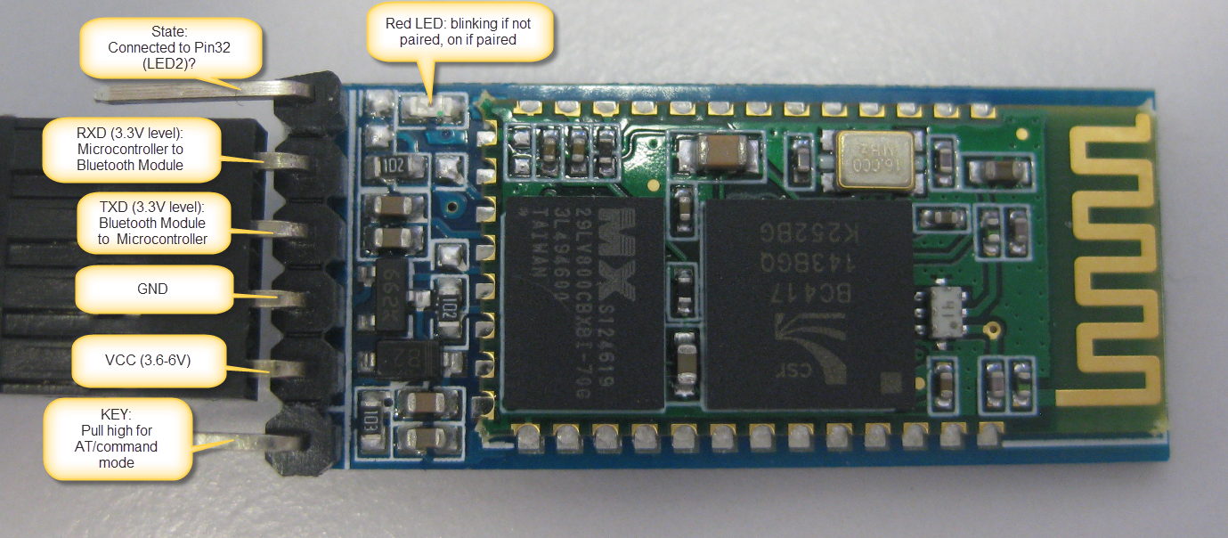
Safety feature: Kill switch
Must be able to stop the car
RF switch and electromagnetic interference
Bluetooth switch
Source: mcuoneclipse.com

Slide 18
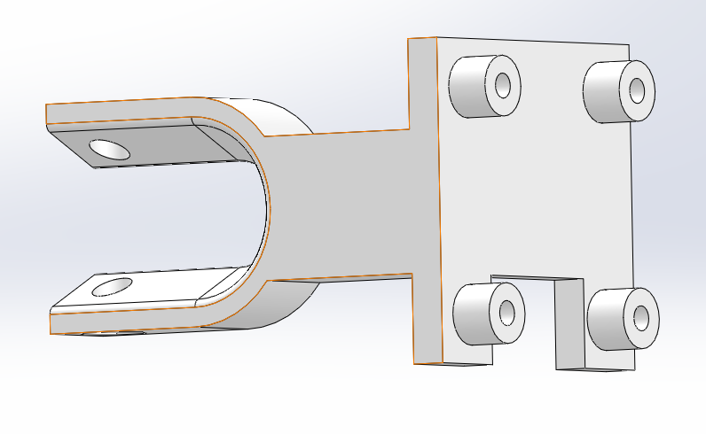
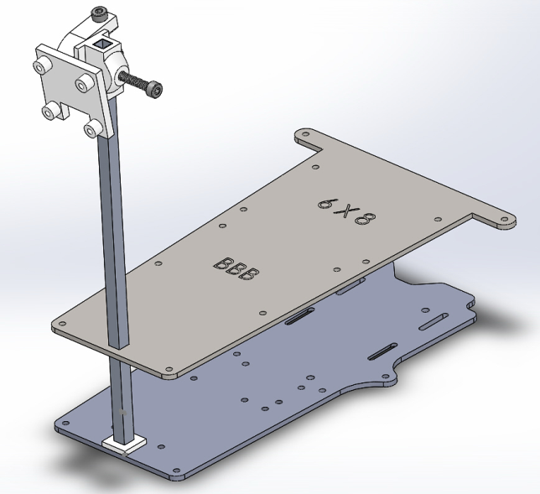
Hardware integration I
3D-printed camera mounts
Aluminum camera mast
Designed platform in SolidWorks
CNC-machined carbon fiber
top plate

Slide 19
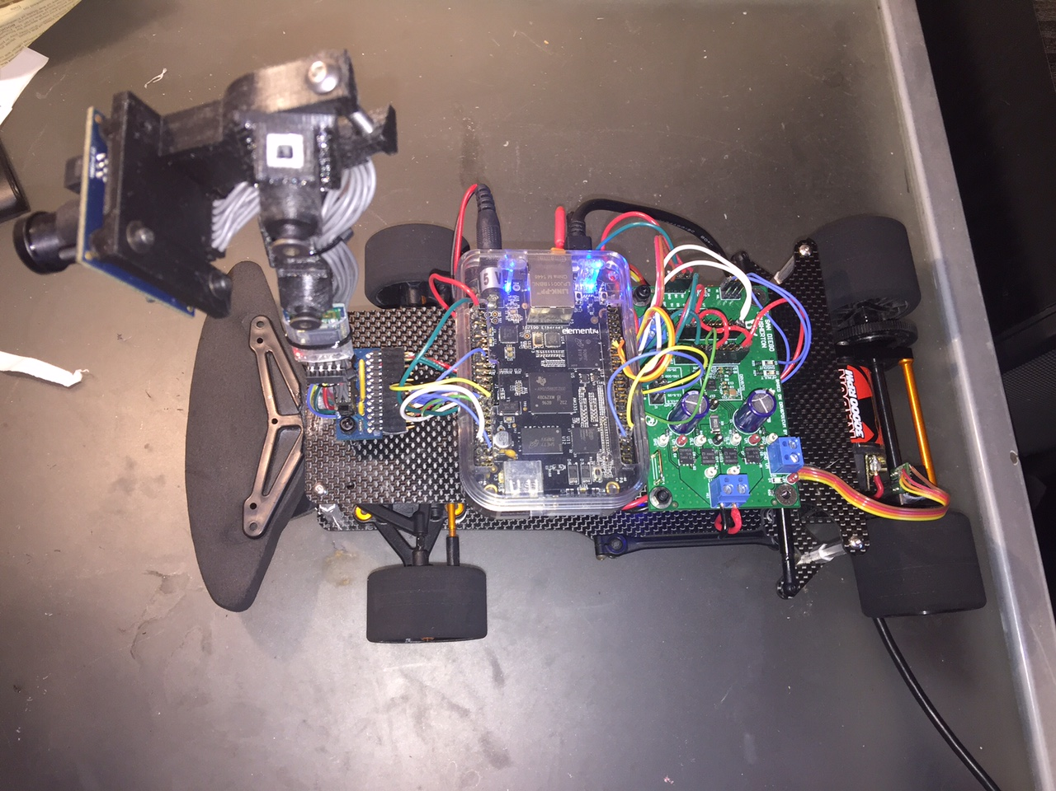
Hardware integration ii

Slide 20
Testing Results
Achieved speeds exceeding 10.5 ft/s
Small oscillations but consistent stability

Slide 21
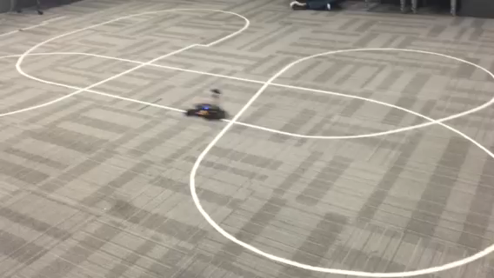

Slide 22
Race results
Did not finish at UCSD’s Grand PrIEEE race
Camera’s IR filter fell off lens
Readings were at saturation level
Beaglebone’s USB port broke during race
Finished 6th place at UC Davis’s NATCAR race
Performance improved after removing IR filter
Car hopping
Loose power connection killed the system in best run

Slide 23
Lessons learned
Always have backups
Inspect all system components
Fixing issues before proceeding is cheaper
Test under a wide range of conditions

Slide 24
Team management
Approach
Explaining overall system design
Encourage all members to provide input
Breaking down assignments into manageable chunks
Tasks vs results
Utilize all available resources

Slide 25
Resources
$500 Budget (IEEE) – use it wisely!
Maker Space (www.jacobsschool.ucsd.edu/envision)
IEEE Project Space (EBU1 )
Facebook page
Github (https://github.com/isalameh/GrandPrIEEEE_2017.git)

Slide 26
Timeline
Fall:
Week 5: Start meeting with your teams ASAP!
Week 6: Have system design outline complete (preliminary)
Week 7: Put in main Purchases (motor driver, sensor, MCU)
Week 8: Build and test H-Bridge
Week 9: Design PCB layout, Send for fabrication

Slide 27
Timeline II
Winter:
Sensor integration
Dynamic modeling
Controller Design
Spring
Testing, debugging and optimization

Slide 28
Logistics
Read the competition rules (all team members)
Project lifecycle
ID encoding (Tawnee Gomez)
LiPo Batteries (under consideration)

Slide 29
Questions

